Slide 1


Major Project
Title:
Online Voting System
Presented by: Eshan Singh
500091330
Guided by:
School of Computer Science

Slide 2
Content
Topic | Page
1.Introduction
2.Problem Statement
3.Motivation
4.Objectives
5.Tech Stack
6.Methodology
7.Implementation
8.Objectives Covered
9.References

Slide 3
1. Introduction
Web-Based System: The Online Voting System is a web-based application that centralizes data on voters, candidates, and election results.
SMS Confirmation: The system uses SMS to confirm votes, enhancing security and verification.
Time-Saving: This system saves time and reduces workload by making information readily available.
Security: It prioritizes data security, ensuring the integrity of the voting process.
Election Commission of India: The Election Commission of India oversees and maintains this website for conducting elections.
Simplicity: It offers a simple and secure method of voting, minimizing the time required.
Definition of "VOTE": The term "VOTE" refers to the act of choosing, electing, or determining a preference, typically for leaders in a democratic context.
Common Voting Issues: Common voting issues include voter fraud, inaccessible polling stations, insufficient materials, and inexperienced staff.

Slide 4
2. Problem Statement
The existing manual Voting system consumes more time for Vote Casting. Voter has to wait for vote polling station to vote for a right candidate. The election officers has to be check the voter , this voter can vote in this booth then chek voterID present in voters list of booth those are information will be present then the voter can vote in that booth. The voter had to stand in the queue to cast his vote. All the work is done in paper ballot so it is very hard to locate a particular candidates, some voters cast their votes for all candidates. To overcome of all these problems we have to implement a web application, which is helpful for Voting from any where.

Slide 5
3. Motivation
Web-Based Voting System: The proposal outlines the creation of a web application for the voting process, specifically an Online Voting System using SMS.
Data Management: The system will efficiently manage voter details and candidate information.
User-Friendly: The main feature highlights user-friendliness, allowing voters to log in easily and exercise their voting rights.
Efficient Data Handling: The system will manage information data with high efficiency.
Reliability: The proposed system is touted as more reliable compared to manual methods.
Speed: It is expected to be faster than traditional manual voting systems.
Accuracy: The system promises a high level of accuracy in vote counting and record-keeping.
Ease of Use: It's designed to be easy to handle, ensuring that voters can navigate the process with ease.
Automation: The proposal emphasizes the benefits of automation, reducing errors inherent in manual voting systems.
In summary, this points-based breakdown highlights the key features and advantages of the proposed Online Voting System through SMS.

Slide 6
4. Objectives
here are the key points regarding the objectives and features of the proposed Online Voting System:
Objective - Replacing Traditional System: The primary objective is to replace the existing traditional voting system with a more efficient and modernized one.
Efficiency: The proposed system aims to reduce the time required for the voting process.
Reliability: It emphasizes the reliability of the system, ensuring the integrity of the voting process.
Speed: The system is designed to be faster and more responsive compared to the traditional method.
Authentication via SMS: Voter authentication is achieved through the use of SMS, with usernames and passwords sent to the voters via text messages.
Confirmation via OTP: Voters confirm their votes by entering a One-Time Password (OTP) sent to their mobile numbers.
Database Management: The system will maintain a database containing information about voters, candidates, and the final results of the votes.
These points succinctly outline the objectives and key features of the proposed Online Voting System, highlighting its efficiency, reliability, and use of SMS-based authentication and confirmation.

Slide 7
5. Technology Stack
• Operating System: Windows
• Scripting Language: JSP
• Back-End: MYSQL .
• Front-End: HTML5 and CSS3
• Supporting Tools: NetBeans IDE, JQUERY
• Type: Web Application.
• Server: TOMCAT 8.0(cross platform, Apache, MYSQL, JSP)
• Java Version : J2SDSK1.5

Slide 8
6. Methodology
1. Define Project Scope
Objective: Develop a secure and user-friendly online voting system that allows registered users to cast their votes electronically.
Deliverables:
A functional web application.
Documentation of the system including requirements, design, and user manual.
Test cases and results.
2. Gather Requirements
Functional Requirements:
User registration and login.
User authentication.
Voting mechanism.
Admin dashboard to manage elections, candidates, and results.
Real-time vote tallying.
Secure storage of votes.
Non-functional Requirements:
Security: Data encryption, secure authentication, and protection against common vulnerabilities.
Usability: User-friendly interface.
Performance: Fast response time, scalable to handle multiple users.

Slide 9
6. Methodology (contd.)
3. System Design
Architectural Design:
Use a multi-tier architecture (Presentation Layer, Business Logic Layer, Data Access Layer).
Database Design:
Define tables for users, candidates, votes, and elections.
User Interface Design:
Create wireframes for user registration/login, voting page, and admin dashboard.
4. Technology Stack
Frontend:
HTML, CSS, JavaScript for the user interface.
Frameworks like React or Angular for a more dynamic frontend.
Backend:
Java with Spring Boot, Node.js with Express, or Python with Django for handling server-side logic.
Database:
MySQL, PostgreSQL, or MongoDB for storing data.
Security:
SSL/TLS for secure communication.
Hashing passwords (e.g., using bcrypt).
Secure session management.

Slide 10
6. Methodology (contd.)
5. Implementation
1. Set Up the Development Environment:
Install necessary software (e.g., IDE, database, web server).
2. Develop the Backend:
Create RESTful APIs for user registration, login, voting, and admin operations.
Implement authentication and authorization.
3. Develop the Frontend:
Build the user interface based on the design.
Integrate with the backend APIs.
4. Integrate Security Measures:
Implement HTTPS.
Securely store passwords.
Validate and sanitize inputs to prevent attacks.

Slide 11
6. Methodology (contd.)
8. Documentation
1. Technical Documentation:
Include architecture diagrams, API documentation, database schema, etc.
2. User Manual:
Provide instructions on how to use the system.
3. Maintenance Guide:
Document procedures for maintaining and updating the system.

Slide 12
6. Methodology (contd.)
6. Testing
1. Unit Testing:
Test individual components (e.g., user registration, voting).
2. Integration Testing:
Test the interaction between different components (e.g., frontend and backend).
3. System Testing:
Test the entire system for functionality, performance, and security.
4. User Acceptance Testing (UAT):
Conduct testing with a small group of users to get feedback.
7. Deployment
1. Set Up the Production Environment:
Configure the web server, database, and security settings.
2. Deploy the Application:
Deploy the application to a cloud platform (e.g., AWS, Heroku) or an on-premises server.
3. Perform Post-deployment Testing:
Ensure the system works as expected in the production environment.

Slide 13
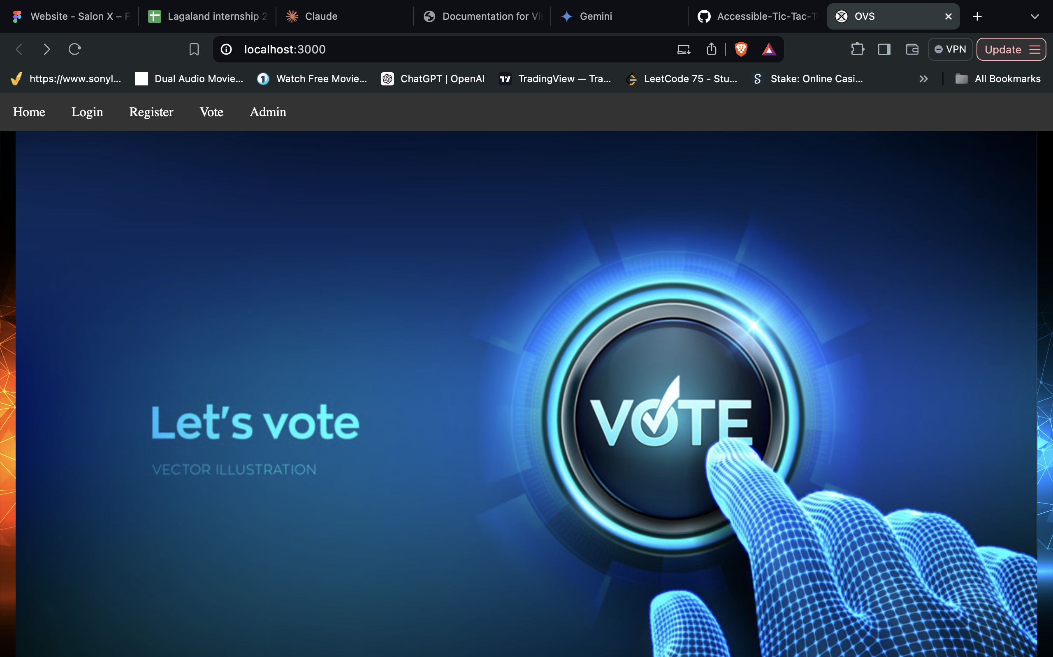
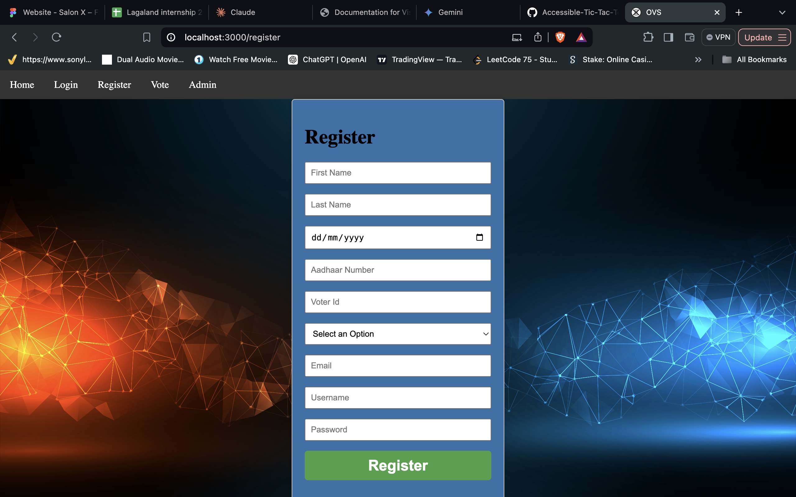
7. Implementation

Slide 14
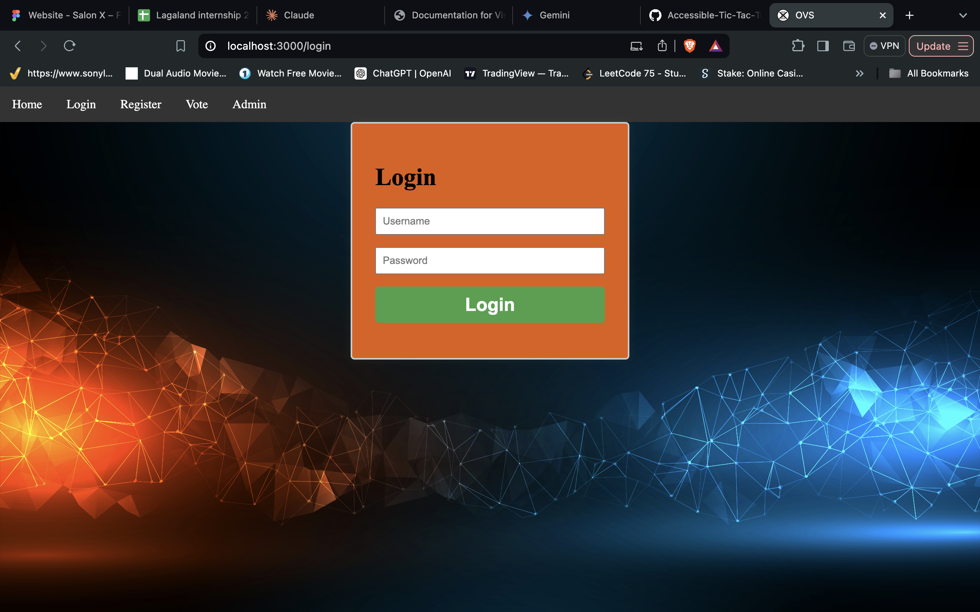
7. Implementation

Slide 15
7. Implementation

Slide 16
7. Implementation

Slide 17
8. Objectives Covered
Objectives | Status
Objective - Replacing Traditional System | Completed
Efficiency | Completed
Reliability | Completed
Speed | Completed
Authentication via SMS | Completed
Confirmation via OTP | Completed
Database Management | Completed

Slide 18
9. References
[1] https://www.w3schools.com
[2] https://en.wikipedia.org/wiki/Electronic_voting
[3]https://www.eac.gov/
[4]https://dl.acm.org/ [5]https://www.javatpoint.com [6]https://www.tutorialspoint.com/Deadlock-in-Java-Multithreading

Slide 19
Thank You

